Slide 1

OPERATING SYSTEMS
Multi-Processor Scheduling
Venkatesh Prasad
Department of Computer Science

Slide 2

OPERATING SYSTEMS
Slides Credits for all PPTs of this course
The slides/diagrams in this course are an adaptation, combination, and enhancement of material from the following resources and persons:
Slides of Operating System Concepts, Abraham Silberschatz, Peter Baer Galvin, Greg Gagne - 9th edition 2013 and some slides from 10th edition 2018
Some conceptual text and diagram from Operating Systems - Internals and Design Principles, William Stallings, 9th edition 2018
Some presentation transcripts from A. Frank – P. Weisberg
Some conceptual text from Operating Systems: Three Easy Pieces, Remzi Arpaci-Dusseau, Andrea Arpaci Dusseau

Slide 3
Operating systems
Multi-Processor Scheduling
Venkatesh Prasad
Department of Computer Science

Slide 4
OPERATING SYSTEMS
Multiple-Processor Scheduling
CPU scheduling more complex when multiple CPUs are available
Homogeneous processors within a multiprocessor
Asymmetric multiprocessing – only one processor accesses the system data structures, alleviating the need for data sharing
Symmetric multiprocessing (SMP) – each processor is self-scheduling, all processes in common ready queue, or each has its own private queue of ready processes
Currently, most common
Processor affinity – process has affinity for processor on which it is currently running
soft affinity
hard affinity
Variations including processor sets
Notes:
For ex: Linux implements soft affinity, but it also provides the sched_setaffinity() system call, which supports hard affinity

Slide 5
OPERATING SYSTEMS
Multiple-Processor Scheduling (Cont.)
Multiprocess may be any one of the following architectures:
Multicore CPUs
Multithreaded cores
NUMA systems
Heterogeneous multiprocessing

Slide 6
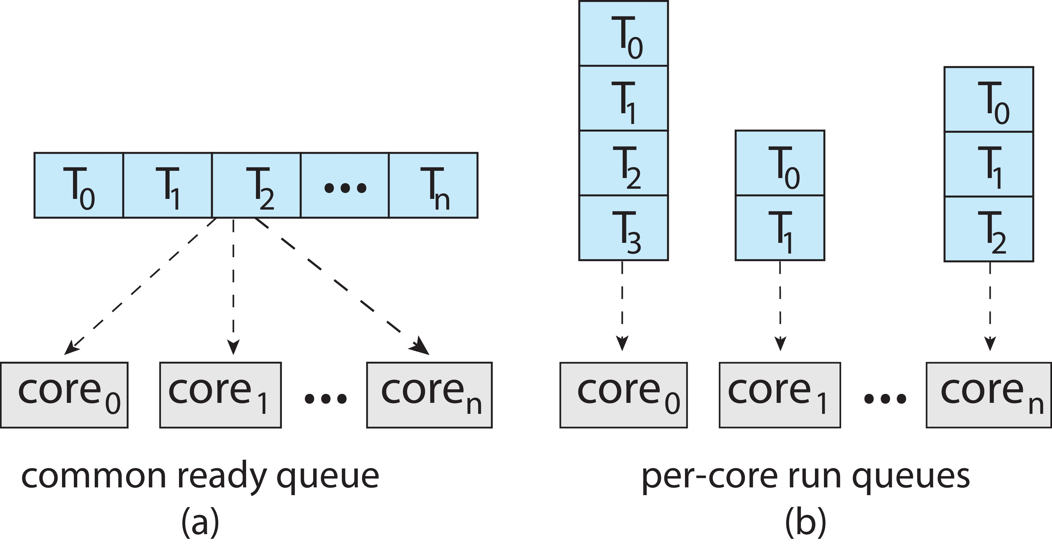
OPERATING SYSTEMS
Multiple-Processor Scheduling (Cont.)
Symmetric multiprocessing (SMP) is where each processor is self scheduling.
All threads may be in a common ready queue (a)
Each processor may have its own private queue of threads (b)
© Silberschatz, Galvin and Gagne, 2018

Slide 7
OPERATING SYSTEMS
NUMA and CPU Scheduling
Note that memory-placement algorithms can also consider affinity

Slide 8
OPERATING SYSTEMS
Multiple-Processor Scheduling – Load Balancing
If SMP, need to keep all CPUs loaded for efficiency
Load balancing attempts to keep workload evenly distributed
Push migration – periodic task checks load on each processor, and if found pushes task from overloaded CPU to other CPUs
Pull migration – idle processors pulls waiting task from busy processor
Load balancing often counteracts the benefits of process affinity

Slide 9
OPERATING SYSTEMS
Multiple-Processor Scheduling – Processor Affinity
When a thread has been running on one processor, the cache contents of that processor stores the memory accesses by that thread.
We refer to this as a thread having affinity for a processor (i.e., “processor affinity”)
Load balancing may affect processor affinity as a thread may be moved from one processor to another to balance loads, yet that thread loses the contents of what it had in the cache of the processor it was moved off of.
Soft affinity – the operating system attempts to keep a thread running on the same processor, but no guarantees.
Hard affinity – allows a process to specify a set of processors it may run on.

Slide 10
OPERATING SYSTEMS
Multicore Processors
Recent trend to place multiple processor cores on same physical chip
Faster and consumes less power
Multiple threads per core also growing
Takes advantage of memory stall to make progress on another thread while memory retrieve happens
Memory stall is the situation when a processor accesses memory, it spends a significant amount of time waiting for the data to become available.
Each core has > 1 hardware threads. If one thread has a memory stall, switch to another thread!

Slide 11
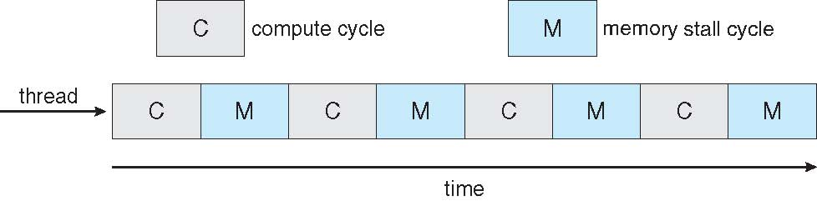

OPERATING SYSTEMS
Multithreaded Multicore System
Notes:
Example: The UltraSPARC T3 CPU has sixteen cores per chip and eight hardware threads per core. From the
perspective of the operating system, there appear to be 128 logical processors.

Slide 12
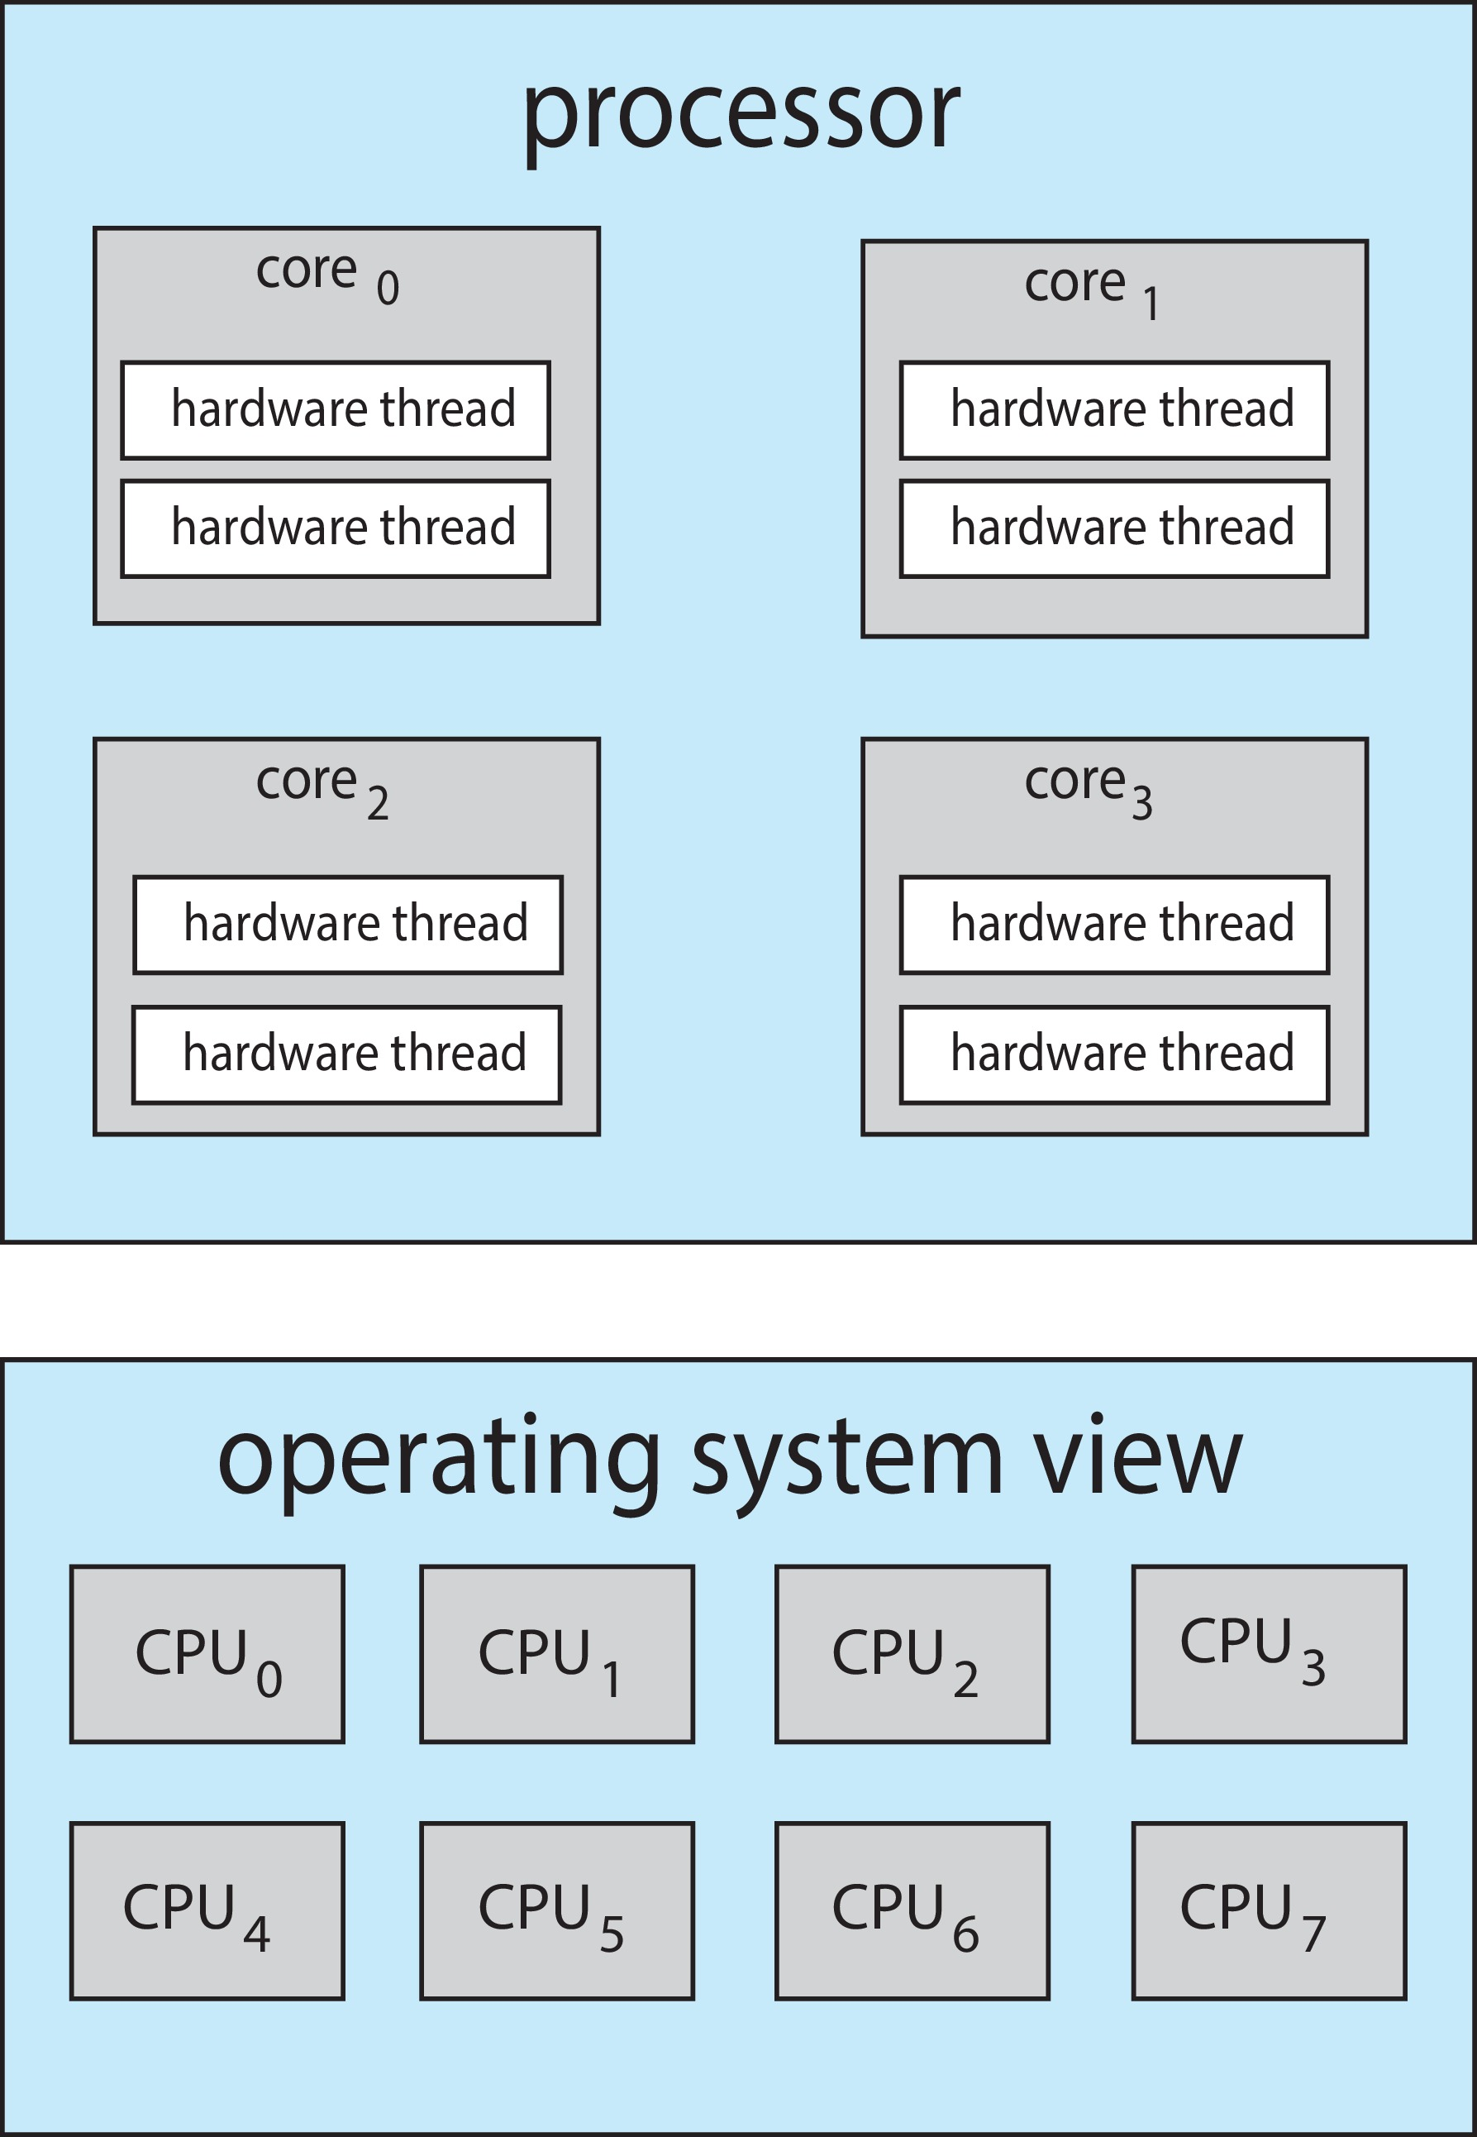
OPERATING SYSTEMS
Multithreaded Multicore System (Cont.)
Chip-multithreading (CMT) assigns each core multiple hardware threads. (Intel refers to this as hyperthreading.)
On a quad-core system with 2 hardware threads per core, the operating system sees 8 logical processors.

Slide 13
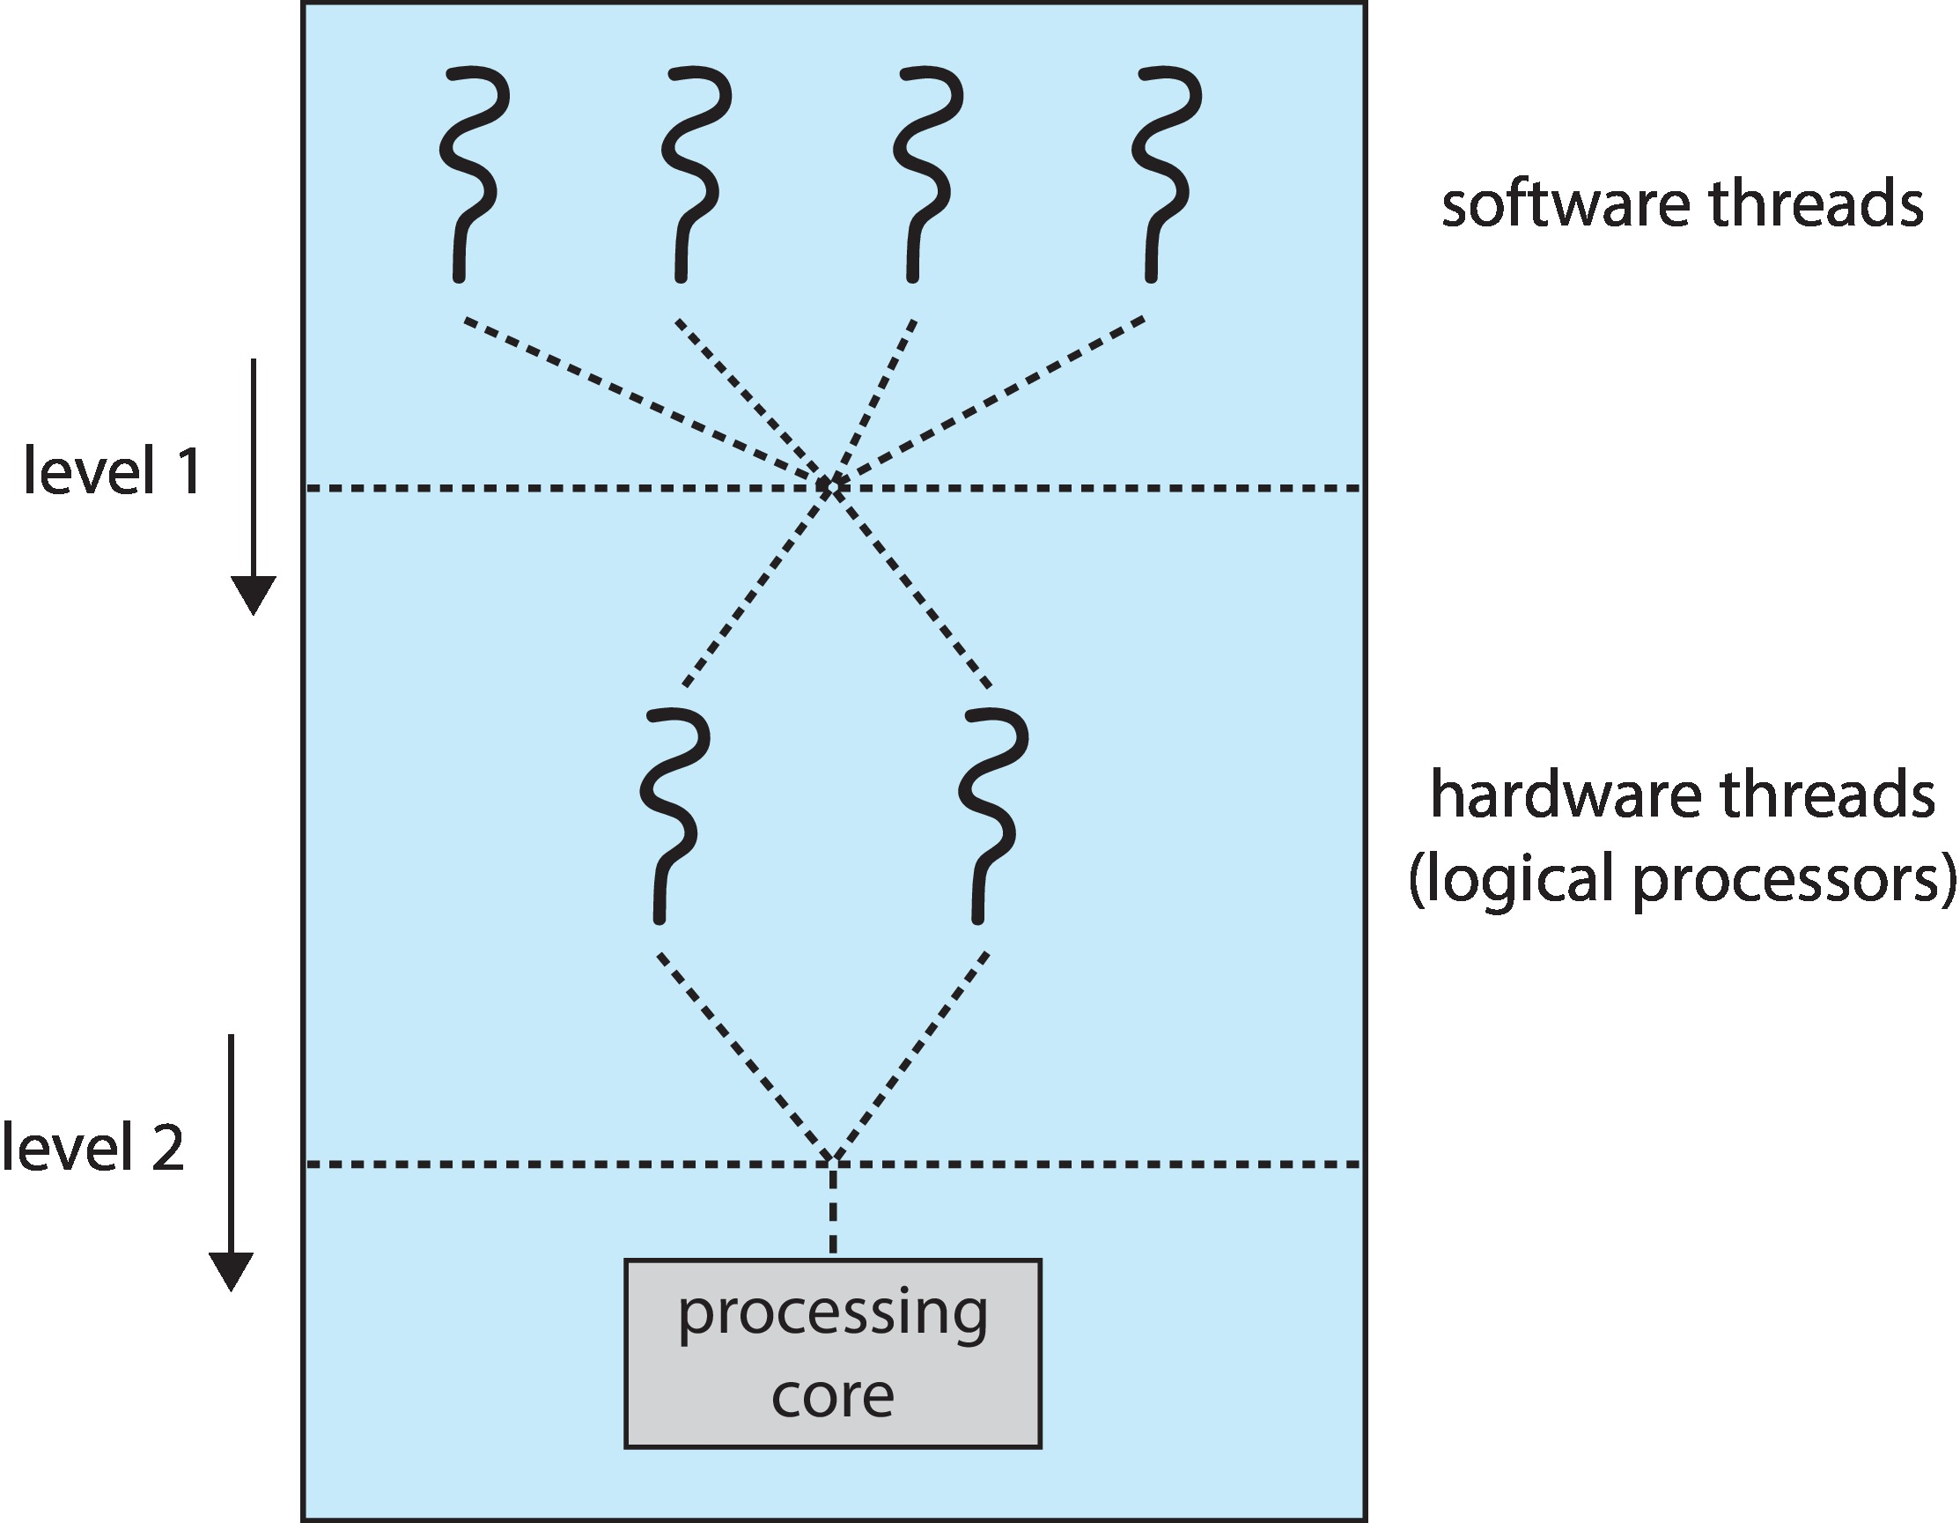
OPERATING SYSTEMS
Multithreaded Multicore System (Cont.)
Two levels of scheduling:
The operating system deciding which software thread to run on a logical CPU
How each core decides which hardware thread to run on the physical core.
© Silberschatz, Galvin and Gagne, 2018

Slide 14
Operating systems
Real-Time CPU Scheduling
Venkatesh Prasad
Department of Computer Science

Slide 15
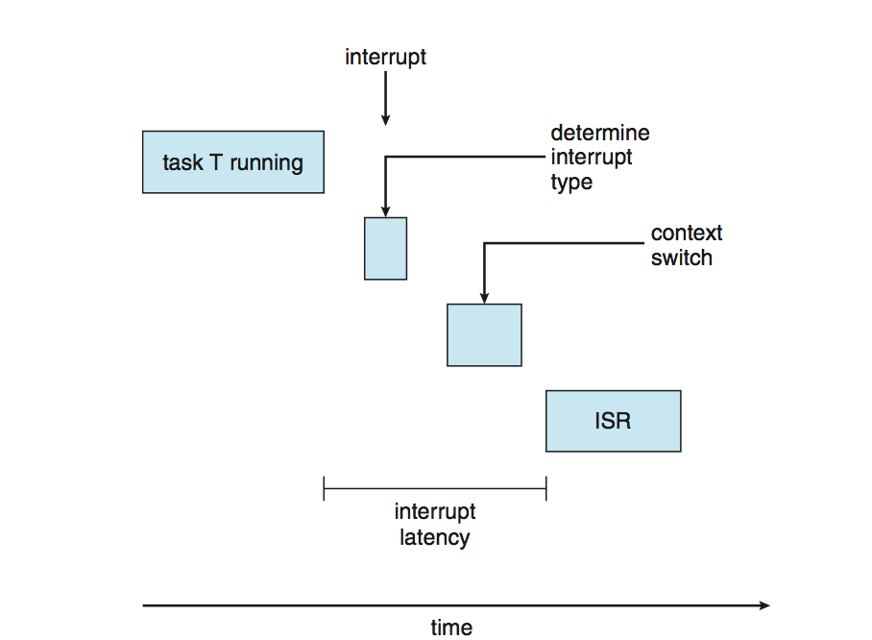
OPERATING SYSTEMS
Real-Time CPU Scheduling
Can present obvious challenges
Soft real-time systems – no guarantee as to when critical real-time process will be scheduled
Hard real-time systems – task must be serviced by its deadline
Two types of latencies affect performance
Interrupt latency – time from arrival of interrupt to start of routine that services interrupt
Dispatch latency – time for schedule to take current process off CPU and switch to another

Slide 16
OPERATING SYSTEMS
Real-Time CPU Scheduling (Cont.)
Conflict phase of dispatch latency:
Preemption of any process running in kernel mode
Release by low-priority process of resources needed by high-priority processes

Slide 17
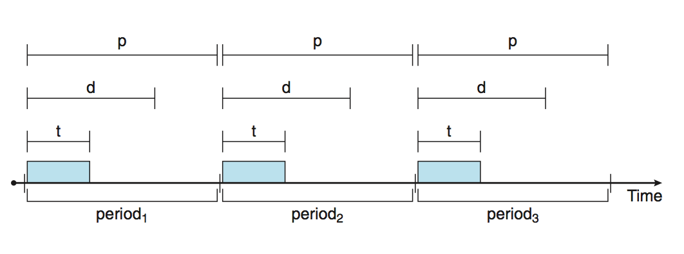
OPERATING SYSTEMS
Priority-based Scheduling
For real-time scheduling, scheduler must support preemptive, priority-based scheduling
But only guarantees soft real-time
For hard real-time must also provide ability to meet deadlines
Processes have new characteristics: periodic ones require CPU at constant intervals
Has processing time t, deadline d, period p
0 ≤ t ≤ d ≤ p
Rate of periodic task is 1/p
Schedulers can take advantage of these characteristics and assign priorities according to a process’s deadline or rate requirements.
Notes:
Periodic processes require the CPU at constant intervals (periods).

Slide 18
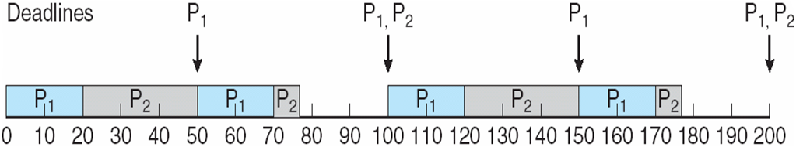
OPERATING SYSTEMS
Rate Monotonic Scheduling
A priority is assigned based on the inverse of its period
Shorter periods = higher priority;
Longer periods = lower priority
P₁ is assigned a higher priority than P₂.

Slide 19
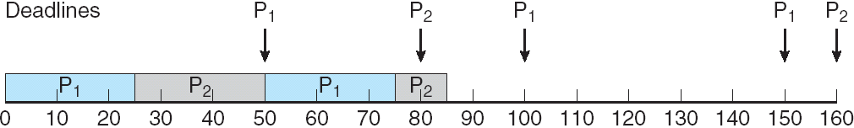
OPERATING SYSTEMS
Missed Deadlines with Rate Monotonic Scheduling

Slide 20
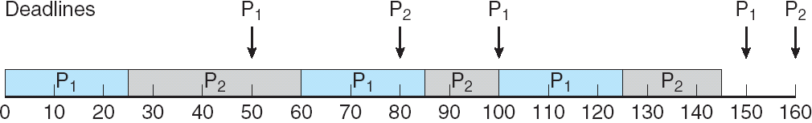
OPERATING SYSTEMS
Earliest Deadline First Scheduling (EDF)
Priorities are assigned according to deadlines: the earlier the deadline, the higher the priority;
the later the deadline, the lower the priority

Slide 21
OPERATING SYSTEMS
Proportional Share Scheduling
T shares are allocated among all processes in the system
An application receives N shares where N < T
This ensures each application will receive N / T of the total processor time

Slide 22
OPERATING SYSTEMS
POSIX Real-Time Scheduling
The POSIX.1b standard
API provides functions for managing real-time threads
Defines two scheduling classes for real-time threads:
SCHED_FIFO - threads are scheduled using a FCFS strategy with a FIFO queue. There is no time-slicing for threads of equal priority
SCHED_RR - similar to SCHED_FIFO except time-slicing occurs for threads of equal priority
Defines two functions for getting and setting scheduling policy:
pthread_attr_getsched_policy(pthread_attr_t *attr, int *policy)
pthread_attr_setsched_policy(pthread_attr_t *attr, int policy)

Slide 23
THANK YOU
Venkatesh Prasad
Department of Computer Science Engineering
venkateshprasad@pes.edu

